Slide 1
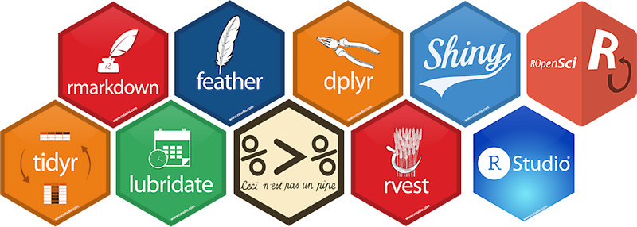
Using R as a Research Tool.
NERC E3 DTP Training – 17th November 2020
Dr Susan Johnston, Institute of Evolutionary Biology
Demonstrator: Lucy Peters

Slide 2
Using R as a Research Tool: Overview
Research Question
Create & Structure an R Project
Data
Visualisation
Statistics
Statistical tests on research data
Loading & managing data
with dplyr
Data visualisation with ggplot2
Publish
Embed code, figures and results in R Markdown

Slide 3
Today’s session:
Carry out basic statistics and visualisations, including:
Chi-squared test with chisq.test()
2-sample t-test with t.test()
Linear regression with lm()
Write, embed and render code and results into an HTML document.

Slide 4
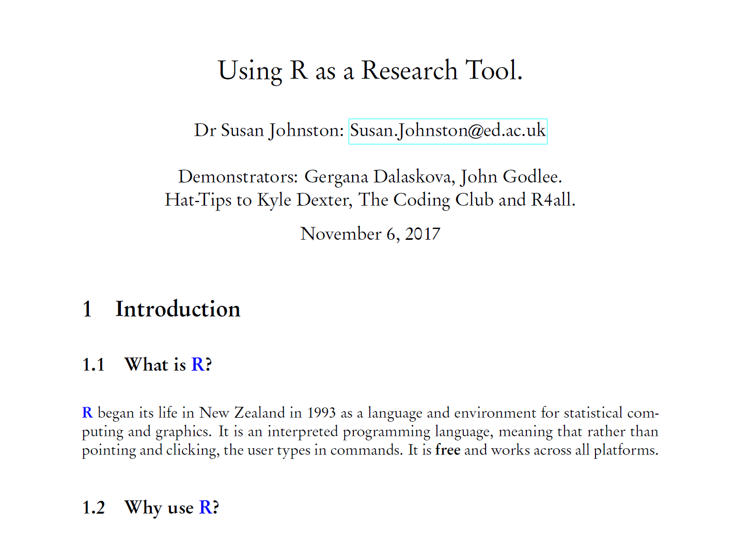
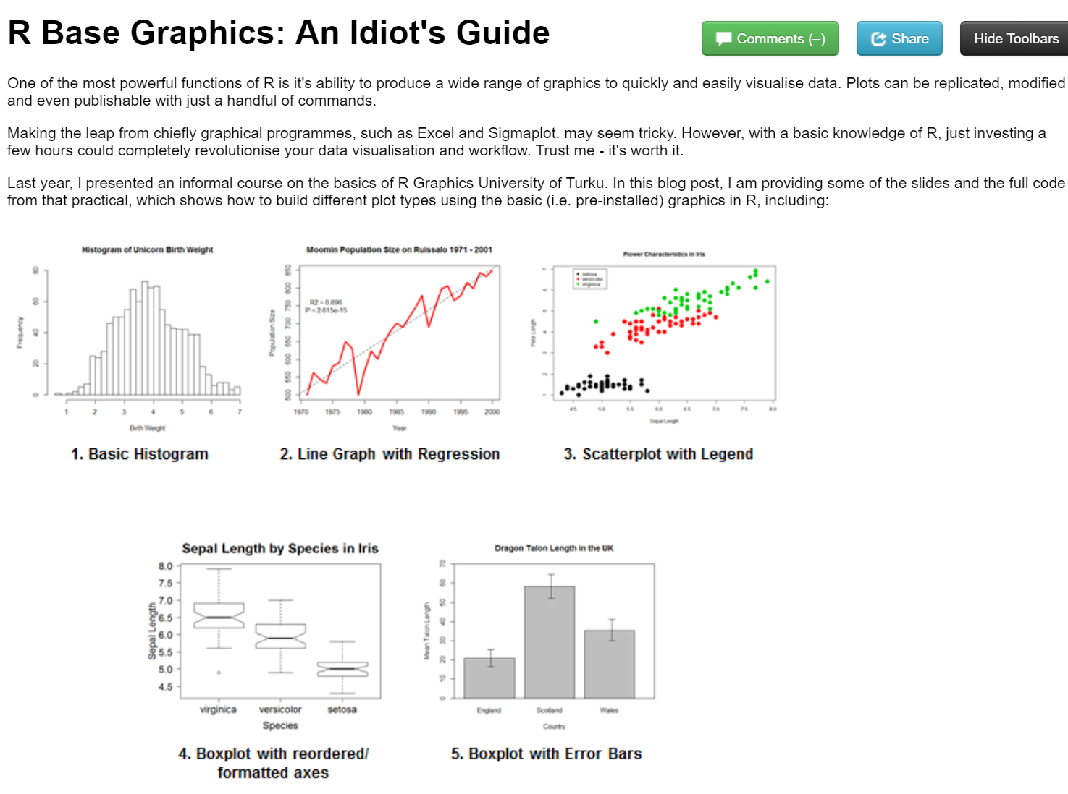
Report writing
LaTeX and R Sweave
knitr to HTML

Slide 5
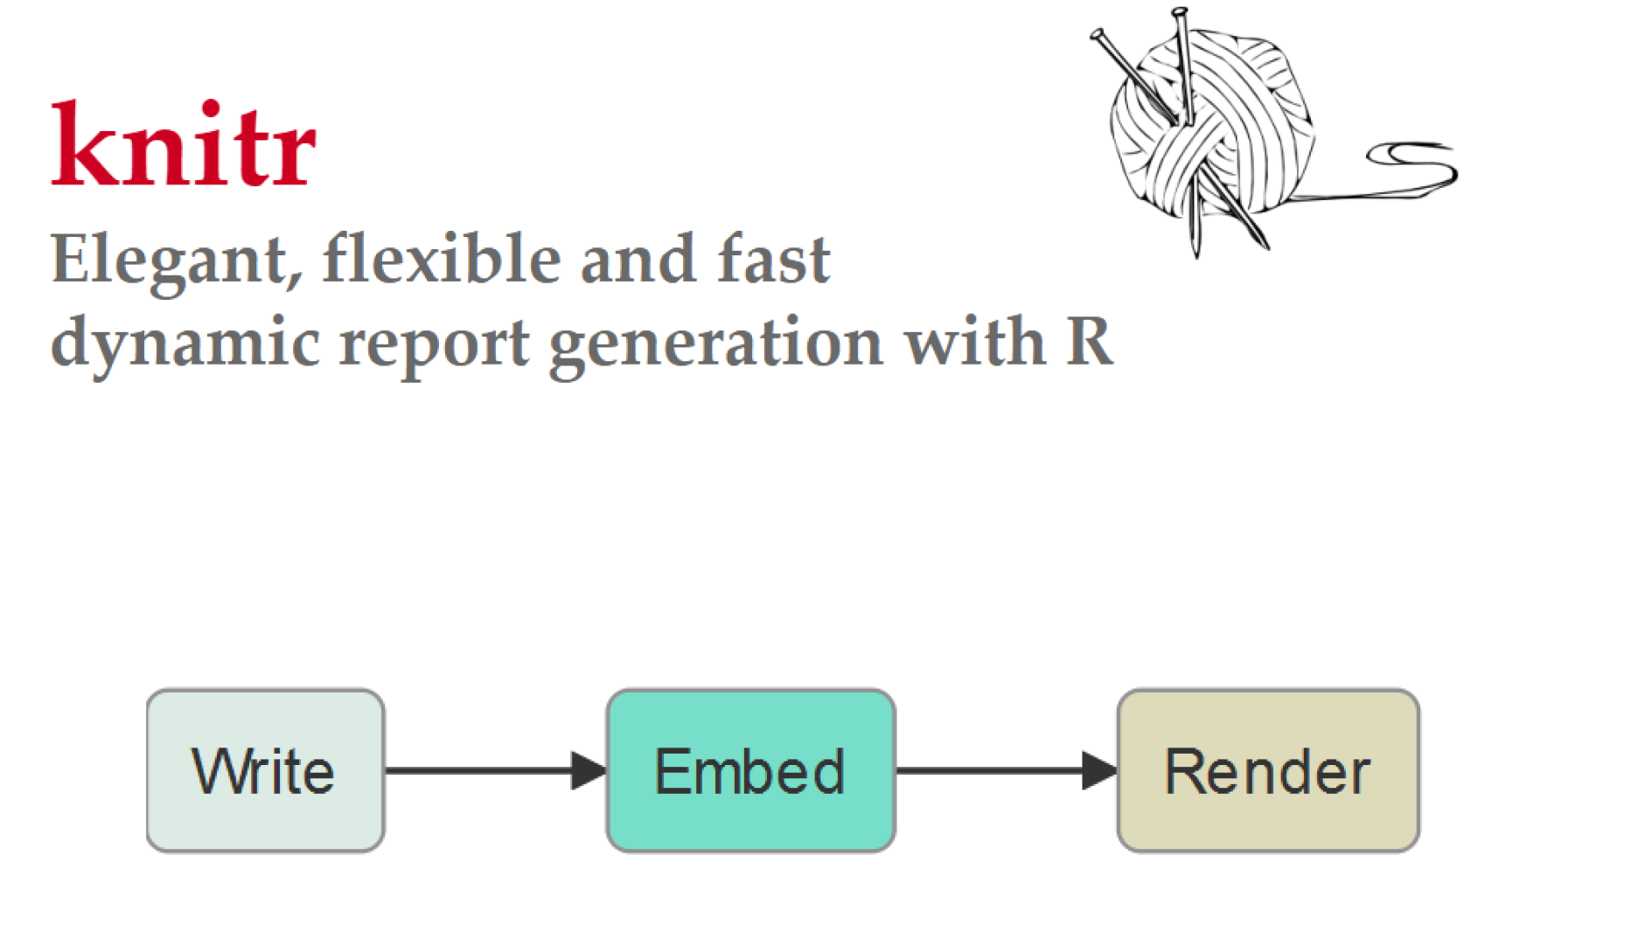
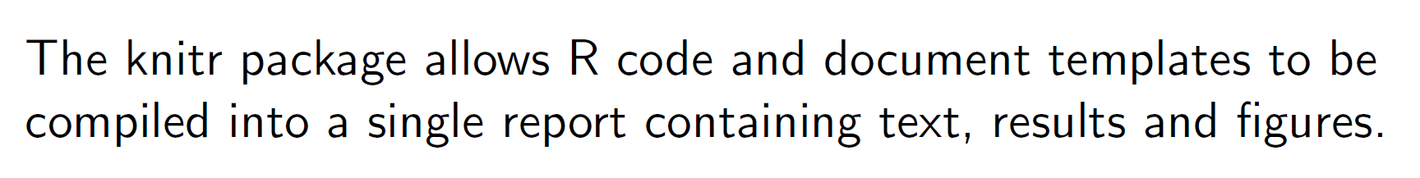

Slide 6
Markdown Language
Lightweight mark-up language
Basic text formatting, adding images, creating lists, etc.
Can embed code and results, making it useful for reproducible research.
Looks very much like regular text with a few extra characters (#, *, etc)
Notes:
formatting words as bold or italic, adding images, and creating lists are just a few of the things we can do with Markdown. Mostly, Markdown is just regular text with a few non-alphabetic characters thrown in, like # or *.

Slide 7
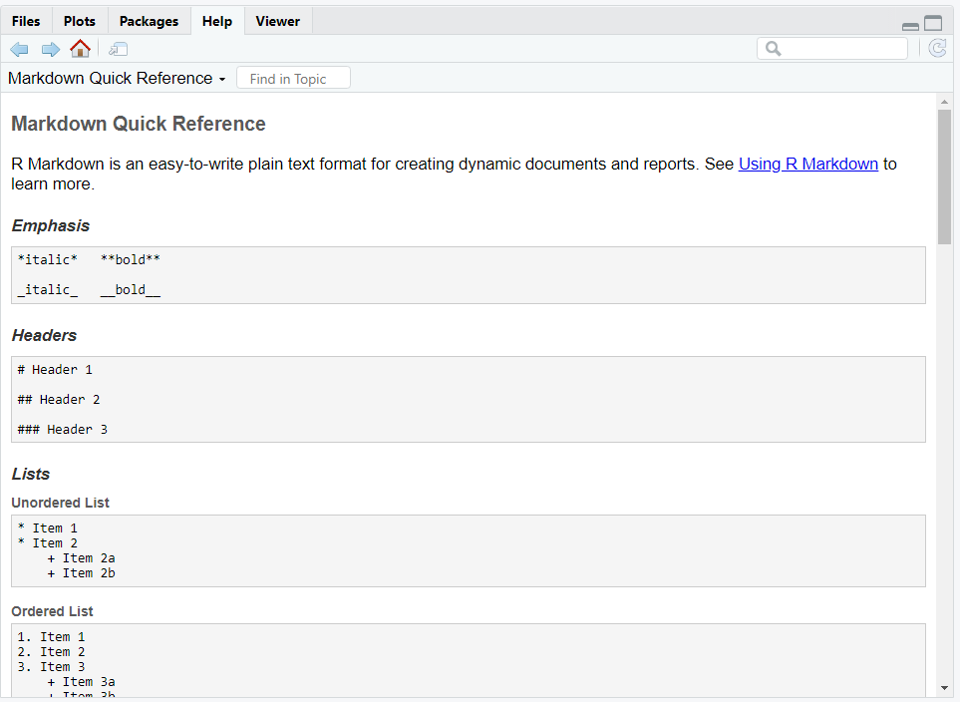

Slide 8
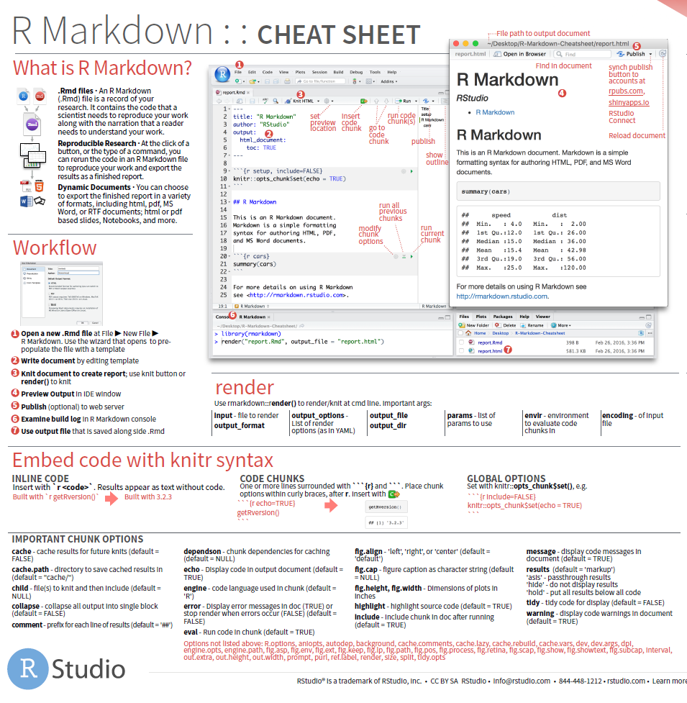

Slide 9
Worked example…

Slide 10
Today’s session:
Carry out basic statistics and visualisations, including:
Chi-squared test with chisq.test()
2-sample t-test with t.test()
Linear regression with lm()
Write, embed and render code and results into an HTML document.

Slide 11
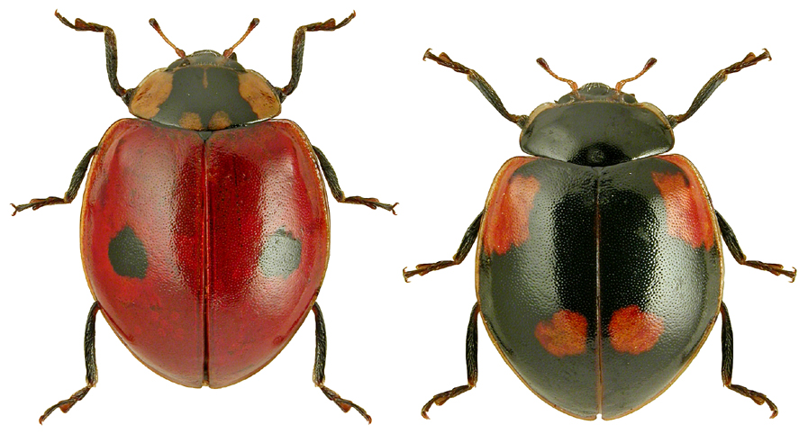
Chi-squared (χ²) contingency table
Analysis of count data
Are dark ladybirds more likely to live in industrial (dark) backgrounds?
Adalia bipunctata

Slide 12
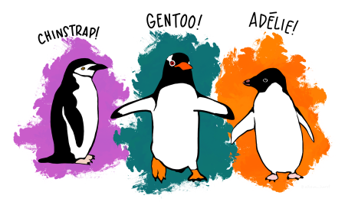
Two sample t-test
Compares the mean of two groups.
Does body weight differ significantly between Adelie and Gentoo penguins?

Slide 13
Simple linear regression
Summarise and study relationships between two continuous variables.
Does flipper length vary relative to body weight in penguins?

Slide 14
Need help?
ASK US!
Use ?, str(), glimpse() to explore functions and objects.
Coding Club tutorials: https://ourcodingclub.github.io/tutorials/
Google & StackOverflow
Feel free to write as a normal R script!

